Slide 1

SACHIN
SANTO ARUL RAJAA SARAN
SHANMUGA MANI
bring gender equality working place

Slide 2






BRAINSTORM
WEEK -1
DESIGN THINKING

Slide 3
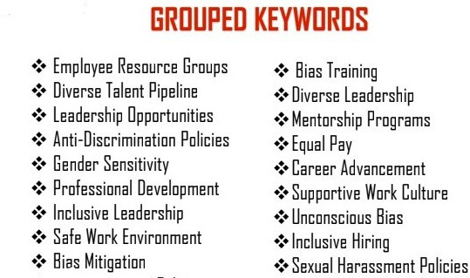

Slide 4




Slide 5

Talent Development
Career Advancement
Diversity Leadership
Diversity Training
Professional Development
Supportive Work Culture
Inclusive Leadership
Gender Sensitivity
MIND
MAPPING
Anti-Discrimination Policies
Inclusive Hiring
Gender-Neutral Policies
Bias Mitigation
Bias Awareness
Equal Pay
Anti-Discrimination Policies
Leadership Work Environment
Recruitment Practices
Gender Equality Strategy

Slide 6


MATRIX TABLE
WEEK - 03

Slide 7
Category | Design Approaches | Equality and Fairness | Bias Identification and Mitigation | Inclusion and Collaboration
What | Designing solutions to address user needs | Ensuring fairness across the process | Identifying and mitigating biases | Engaging diverse perspectives
When | Throughout the problem-solving lifecycle | Across the entire design process | Continuously, especially during research and testing | Throughout the design process
Whom | Designers, Engineers, and Stakeholders | Designers, Users, and Affected Community Members | Design Team, Researchers, and Stakeholders | Designers, Users, and Diverse Stakeholders
Why | To solve problems effectively and user-centered | Practices ensuring their resource and opportunity distribution | To prevent biased decision and promote inclusivity | To incorporate varied perspectives and enhance innovation
How | Applying iterative design methods | Using inclusive policies and standards | Conducting regular bias audits and reviews | Facilitating collaborative and open discussions
Where | In diverse contexts such as product, service, and strategy design | In contexts impacting people and communities | In all design stages susceptible to bias | In brainstorming, prototype, and evaluation phases

Slide 8

WEEK – 4 ACTIVITY
User Participants Mapping

Slide 9
primary users:
tertiary users:
external consultants
industry regulator
professional association
academic researches
advocacy groups
employees
human resources
team leader
executives
diversity
inclusion officers
secondary users:
work place traning
internal policy maker
employee assitance
mentors and coaching
union representation
quaternary users:
media
policy makers
educational institution
community organization
journalist

Slide 10


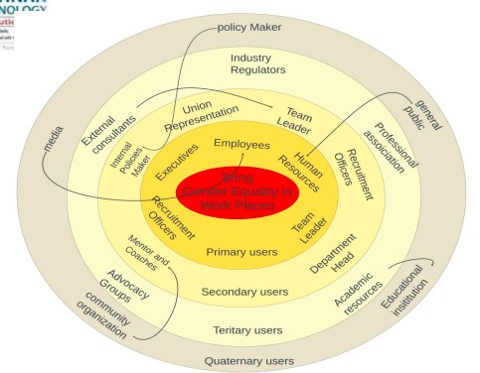






Slide 11
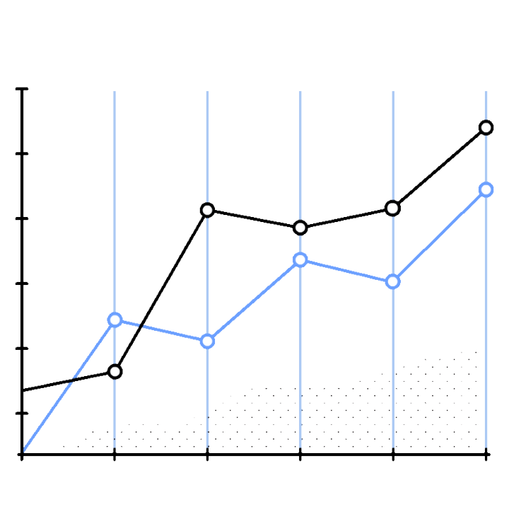

Week 5

Slide 12
Inclusive Workplace 16.7%
Equal Pay 27.8%
Anti-Discrimination 27.8%
Leadership Opportunities 11.1%
Work-Life Balance 16.7%

Slide 13
men
women
100
80
60
40
20
0

Slide 14

A CONCEPTUAL MODEL FOR GENDER EQUALITY IN THE WORKPLACE
Structural Factors
Promotion and Leadership Opportunities Work-Life Balance Initiatives
Anti-Harassment & Discrimination Policies
Cultural Factors
Inclusive Workplace Culture Stereotype Reduction
Behavioral Factors
Training & Awareness Programs Employee Participation & Advoca
Measurement & Accountability Gender Equality Metrics Reporting Mechanisms Leadership Accountability

Slide 15

















QUESTIONNARIES
cue - cards
WEEK - 06

Slide 16






Question 1
How would you define gender equality?
Gender equality is when all
genders have the same
rights and opportunities.

Slide 17





Question 2
THINK
Why do you think gender equality is important in today’s society?
It ensures fairness and allows everyone to contribute equally to society.

Slide 18


Question 3
Which of the photos below shows a gender equal in Society?
A
B

Slide 19

WEEK 7
ARTIFACT, ACTIVITY, MAPPING STEPS:
SPATIAL
BRING GENDER EQUALITY IN WORKING
PLACE

Slide 20

Define artifacts:
identify policies and tools (e.g., equal opportunity policies, diversity training materials) that demonstrate commitment to gender equality.
outline initiatives like training workshops, networking events, and feedback mechanisms to promote gender equality.

Slide 21
conduct spatial mapping:
visualize the workplace layout to analyze gender distribution and assess resource accessibility.
monitor and evaluate: regularly assess initiative effectiveness, gather feedback, and report progress to ensure ongoing commitment.
engage stakeholders: involve employees in discussions and workshops to gather insights and brainstorm solutions.

Slide 22


Slide 23
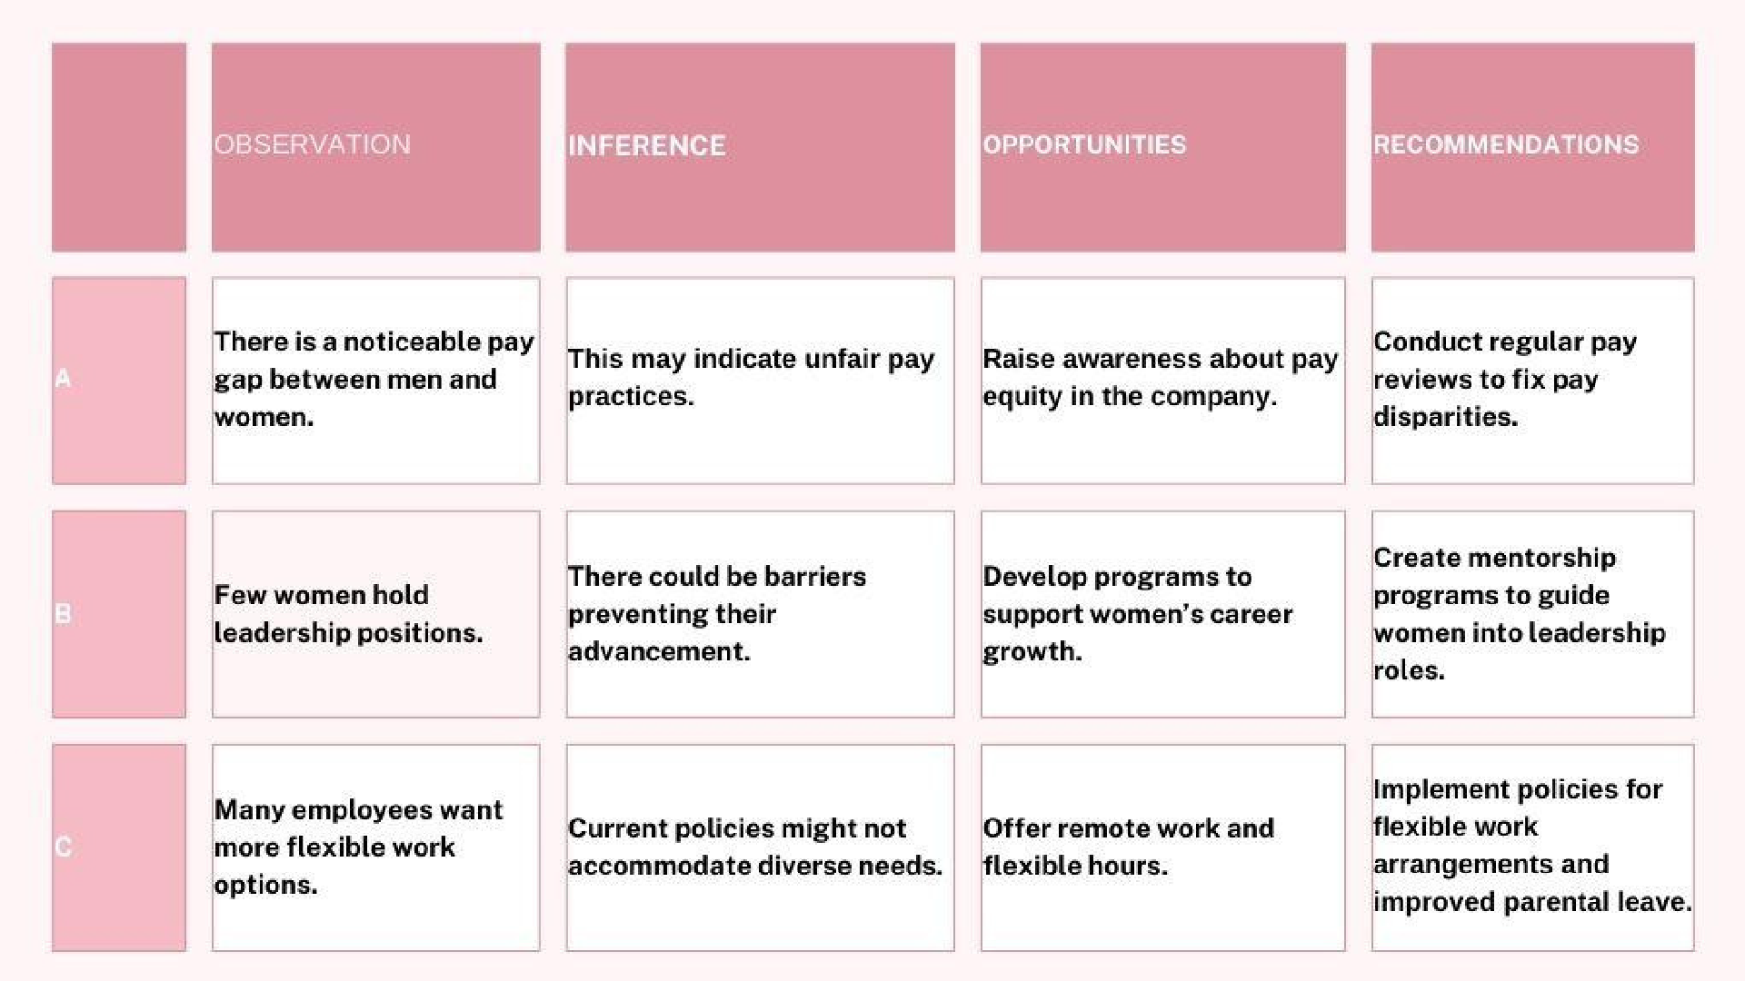

Slide 24

Thank you
For further inquiries and information
SACHIN B SANTO ARUL RAJAA S
SARAN P SHANMUGA MANI M

